Slide 1

Airline Passenger Satisfaction
Course: Data Science with R Programming
Presented by: Abhinav Pradhan

Slide 2
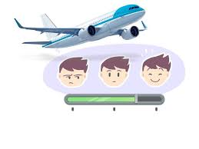
Project Overview
Objective: Analyze airline passenger satisfaction using R.
Dataset size: ~130K rows
Phases:
Data Cleaning Exploratory.
Data Analysis (EDA).
Graphical Reports.
Business Decisions

Slide 3
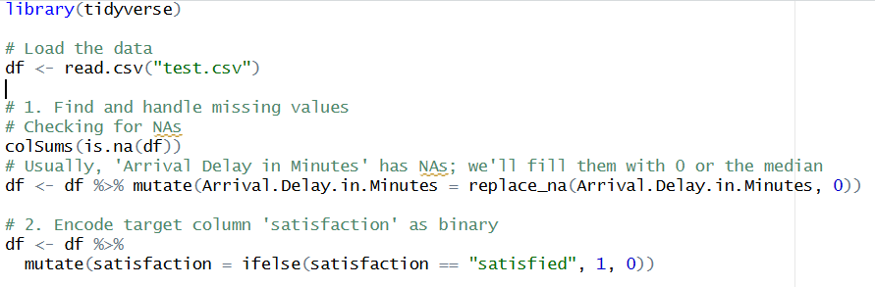
Phase 1 — Data Cleaning
Objective: Prepare the dataset for analysis by handling missing values, irrelevant columns, and scaling.
Target Encoding: Satisfaction column converted to binary: Satisfied = 1, Dissatisfied/Neutral = 0.
Steps:
Missing Values:
Checked with colSums(is.na(df)).
Found NAs in Arrival Delay in Minutes → replaced with 0 (or median).

Slide 4
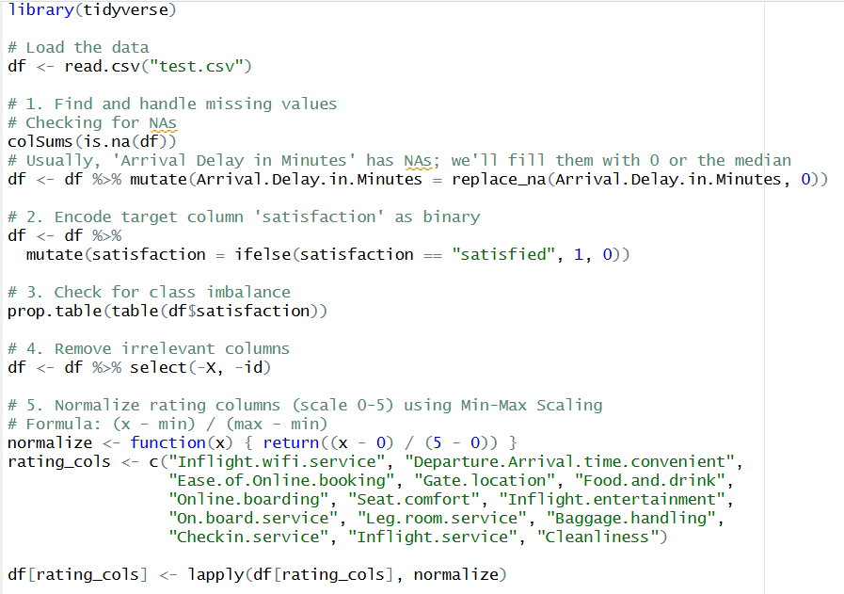
Phase 1 — Data Cleaning
Class Imbalance Check: Used prop.table(table(df$satisfaction)) to measure ratio of satisfied vs dissatisfied passengers.
Irrelevant Columns Removed: Dropped id and Unnamed:0.
Normalization: Rating columns (0–5 scale) normalized using Min-Max scaling → ensures fair comparison across services.

Slide 5
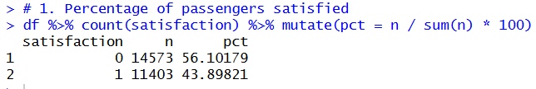
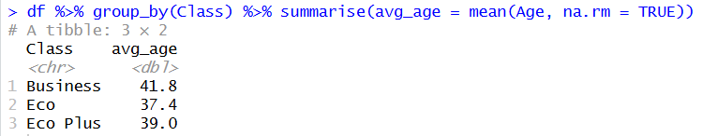
Phase 2 — Exploratory Data Analysis (EDA)
Objective: Discover patterns and insights in passenger satisfaction. Key Analyses:
Passenger Satisfaction Percentage:
  Counted satisfied vs dissatisfied passengers → calculated proportions.
Average Age by Travel Class:
  Grouped by Class (Business, Eco, Eco Plus) → compared mean ages.

Slide 6
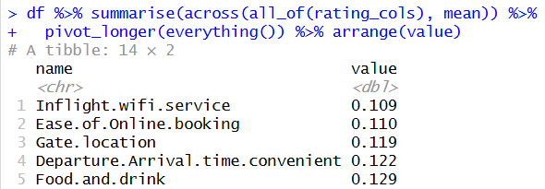
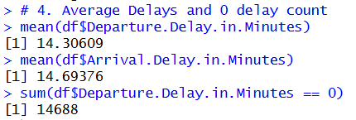
Phase 2 — Exploratory Data Analysis (EDA)
Lowest Rated Service:
  Calculated mean ratings across services (WiFi, Food, Seat Comfort, etc.) → identified weakest service.
Flight Delays:
  Average departure & arrival delays computed.
  Counted flights with 0 delay.

Slide 7
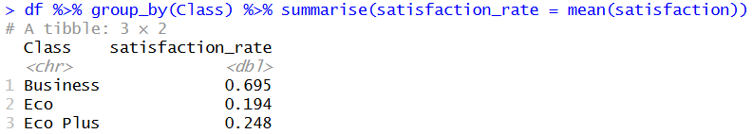
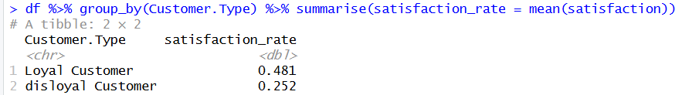
Phase 2 — Exploratory Data Analysis (EDA)
Satisfaction by Class:
  Compared satisfaction rates across Business, Eco, Eco Plus.
Customer Loyalty:
  Grouped by Customer Type (Loyal vs Disloyal) → measured satisfaction differences.

Slide 8
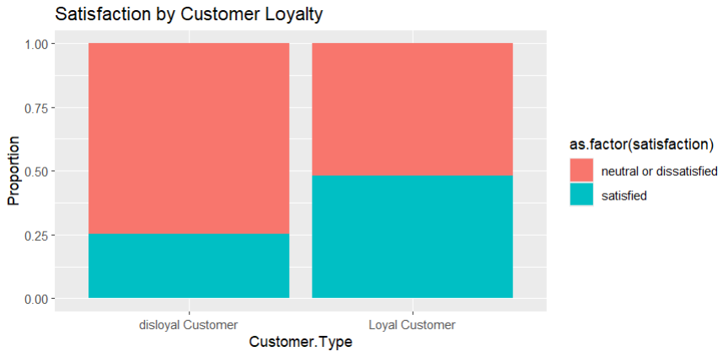
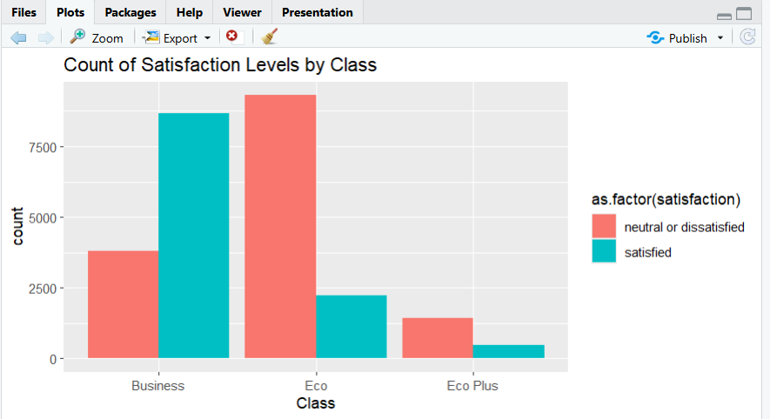

Phase 3 — Graphical Reports
Objective: Visualize findings for better interpretation. Charts & Plots:
1) Bar Chart: Satisfaction rate by Customer Type (Loyal vs Disloyal).
2) Grouped Bar Chart: Satisfaction by Class (Business/Eco/Eco Plus).

Slide 9
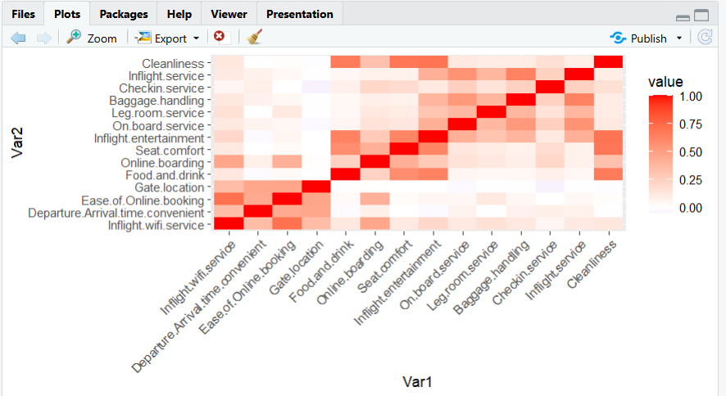
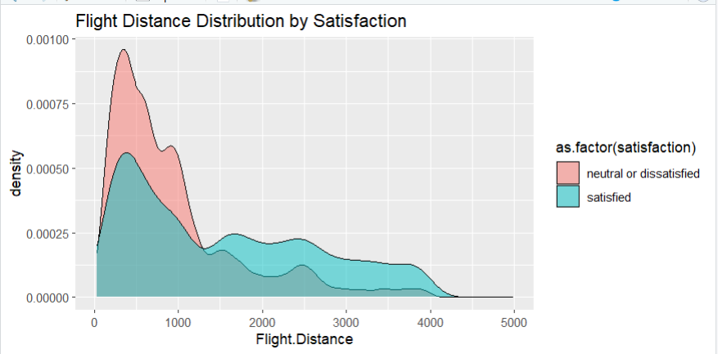
Phase 3 — Graphical Reports
Heatmap: Correlation among service ratings → shows which services are linked.
Density Plot: Flight distance distribution compared between satisfied vs dissatisfied passengers.

Slide 10

Phase 4 — Business Decisions
Objective: Translate insights into actionable strategies for airlines.
Recommendations:
Service Investment:
  Improve lowest-rated services (often WiFi or Food).
Pricing Strategy:
  Business Class shows higher satisfaction → premium pricing justified.
  Economy Class needs service upgrades to justify cost.
Delay Management:
  Satisfaction drops sharply when delays exceed 30–60 minutes.
  Airlines should prioritize reducing delays to improve customer experience.
Customer Loyalty Programs:
  Loyal customers are more satisfied → strengthen loyalty initiatives.

Slide 11

Conclusion
Data-driven insights help airlines improve passenger satisfaction.
Loyal customers show higher satisfaction → strengthen loyalty programs.
Service quality and delay management are key drivers of satisfaction
Business Class satisfaction validates premium pricing strategy

Slide 12

References
Dataset: Kaggle — Airline Passenger Satisfaction
Tools: R Programming (dplyr, ggplot2, reshape2)
Source: Project Lab Work

